Slide 1
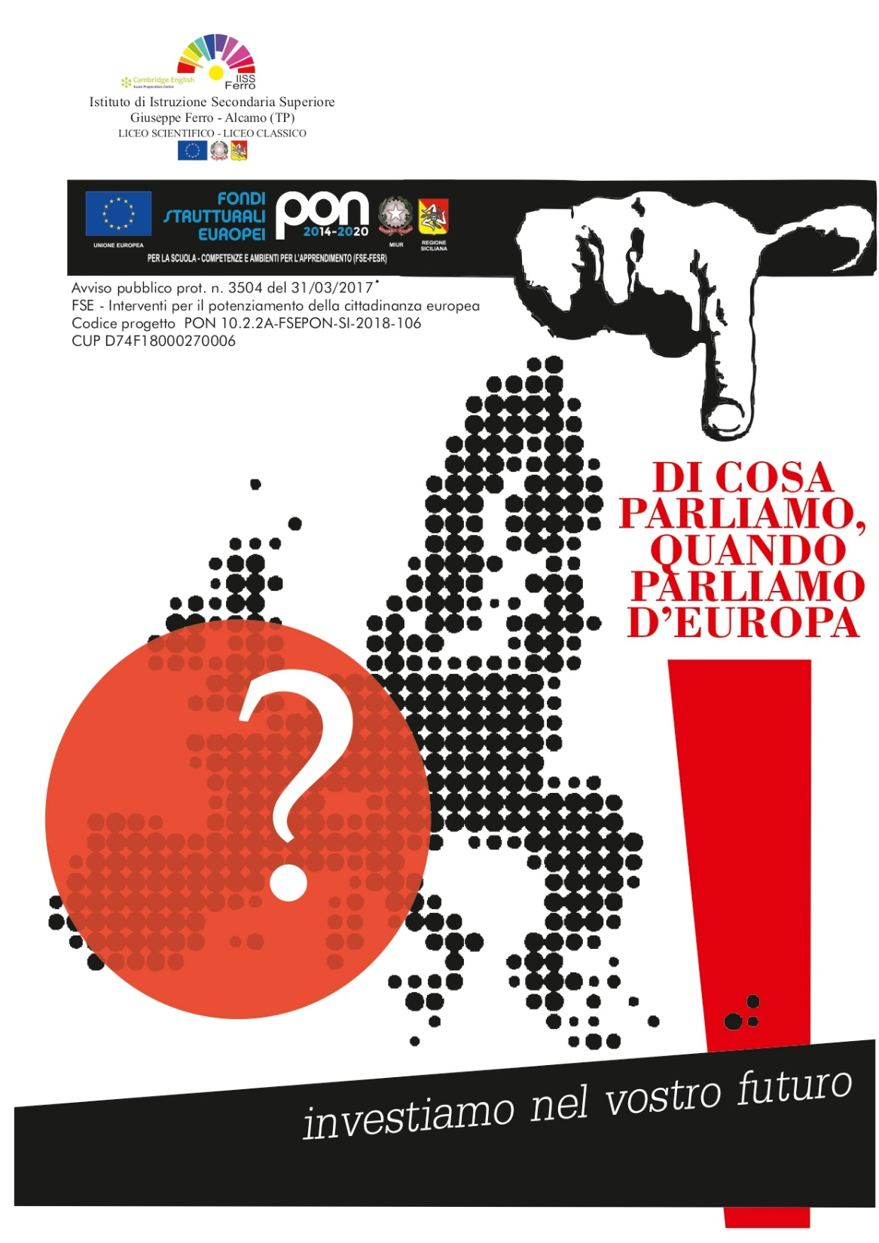
La guerra fredda e il muro di Berlino
Avviso AOODGEFID\003504 del 31/03/2017. Avviso pubblico per il potenziamento della Cittadinanza europea
Codice progetto PON 10.2.2A-FSEPON-SI-2018-106
CUP D74F18000270006

Slide 2
The Cold War and Berlin’s Wall

Slide 3
The western part was administrated by the United States of America, Great Britain and France (Federal Republic of Germany, capital city: Bonn)
The eastern part was under the power of the Soviet Union (Democratic Republic of Germany, capital: Berlin)
During the Cold War, after the Second World War, Germany was divided in two sectors:

Slide 4
Within a short time, the difference in living conditions between East and West Germany had considerably grown. Thanks to the capitalist society that had been set up,the Federal Republic of Germany had a rapid growth. Quite the opposite happened in the Democratic Republic of Germany, where the economy struggled behind the Eastern one and freedom was restricted.

Slide 5
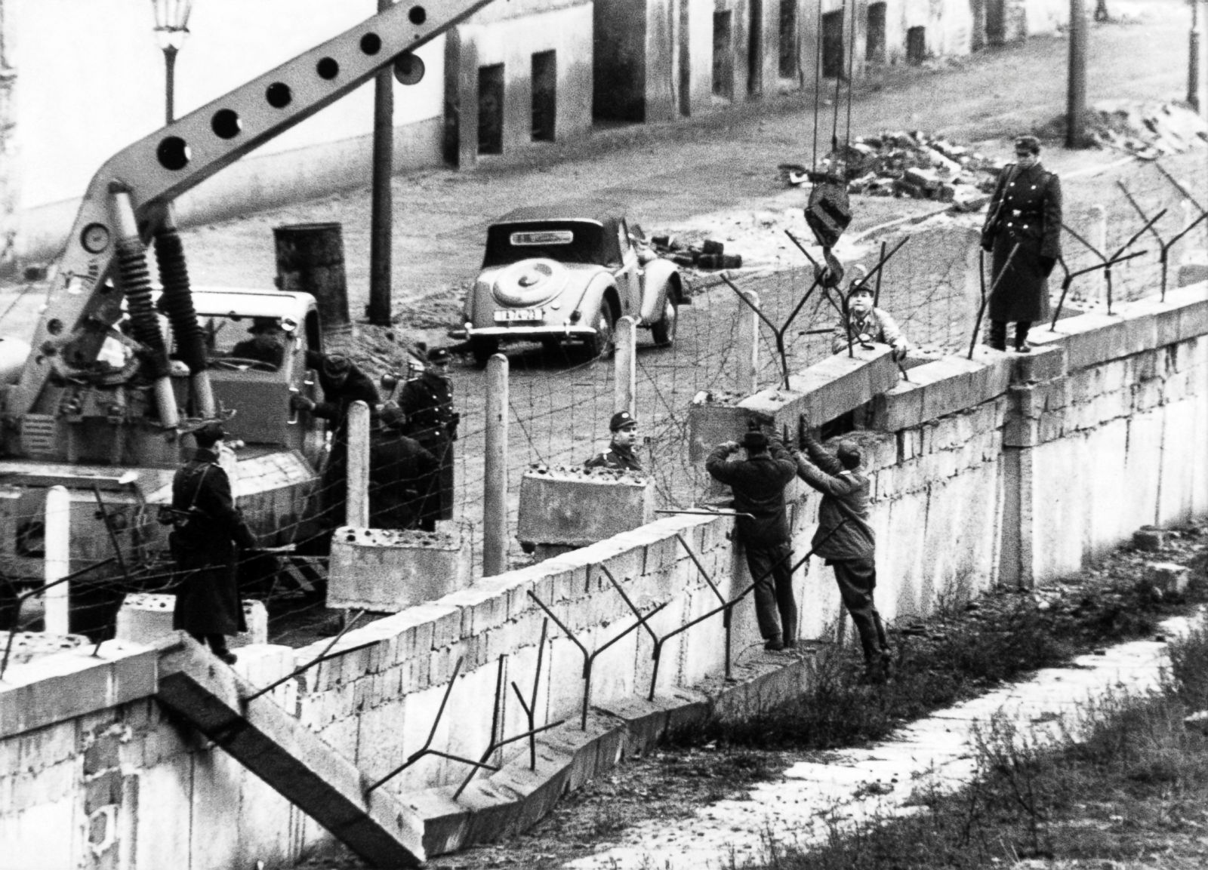
During the night of the 13° August 1961 a 160km long wall was built to divide east and west Berlin. Builders worked all night long and, when eastern Berliners woke up in the morning were taken by surprise due to the barbed wire surrounding their part of the city.

Slide 6
On the 9° November 1989 the Democratic Republic of Germany announced the opening of the border. Thousands of people climbed over the wall and, little by little, Berliners started removing parts of it. This event represented the beginning of the pacification between the Sovietic Germany and the Germany of the allies.

